Slide 1


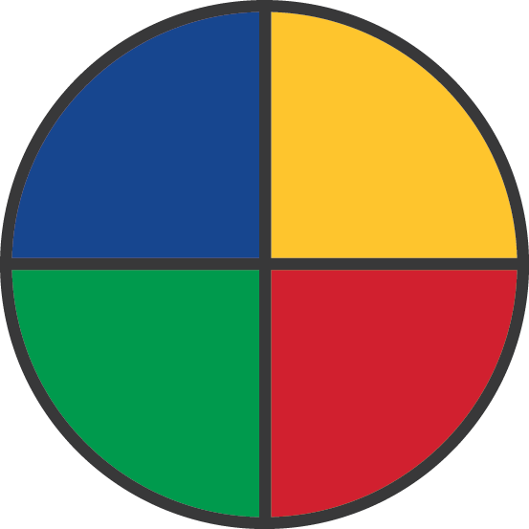
EMERGENETICS ATTRIBUTES
EXPRESSIVENESS
The outward display of emotions toward others and the world at large
ANALYTICAL
Clear thinker
Logical problem
solver
Rational
CONCEPTUAL
Imaginative
Visionary
Intuitive about ideas
ASSERTIVENESS
The style and pace with which you advance thoughts, feelings, and beliefs
STRUCTURAL
Practical Thinker
Likes guidelines
Predictable
SOCIAL
Intuitive about people
Socially aware
Relational
FLEXIBILITY
Willingness to accommodate the
thoughts and actions of others
Notes:
Trainer Note: Display this slide on the screen when groups are working in the MPA exercise so they have the definitions as reference.

Slide 2
WHEN
SPEAKING
TO…
ANALYTICAL
CONCEPTUAL
Cut to the chase
Executive Summary
Ensure Accuracy
Allow Time to Digest
Stay with Big Picture
Invite Their Ideas
Allow for Tangents
Keep Things Fun
Be Organized
Clear Instructions
No Surprises
Stay on Track
Inclusive Discussion
Share the Story
Be Sincere
Brainstorm Together
STRUCTURAL
SOCIAL

Slide 3
PERCEPTIONS IF
OVERUSED
ANALYTICAL
CONCEPTUAL
Intimidating
Uncaring
Skeptical
Weird
Unfocused
Out There
Boring
Nit-Picky
Inflexible
Irrational
Emotional
Pushover
STRUCTURAL
SOCIAL

Slide 4
BUILDING
TRUST
Bottom Line
Intuition – Big Picture
Did they
get it done?
Are they rational?
Will they deliver?
Are they
on board?
Are we headed in
the same direction?
Are they consistent?
Are they dependable?
Are they
practical?
Are they with me?
Do we share
common values?
Predictable
Intuition – Feeling

Slide 5
TEAMWORK
Divide & Conquer
Vision Driven
Rational
decision making
Efficient work
Everyone does his/her job
Brainstorm
new options
Experimentation okay
Energy around change
Take time to organize and create timeline
Follow the
policy/rules
Clear
assignments
Consensus building
Team meetings
and dialogue
Strength based
roles
By the Book
Work Together

Slide 6
STRENGTHS
ANALYTICAL
CONCEPTUAL
Logical
Objective
Researcher
Visionary
Creative
Experimenter
Dependable
Thorough
Predictable
Connector
Empathic
Tactful
STRUCTURAL
SOCIAL

Slide 7
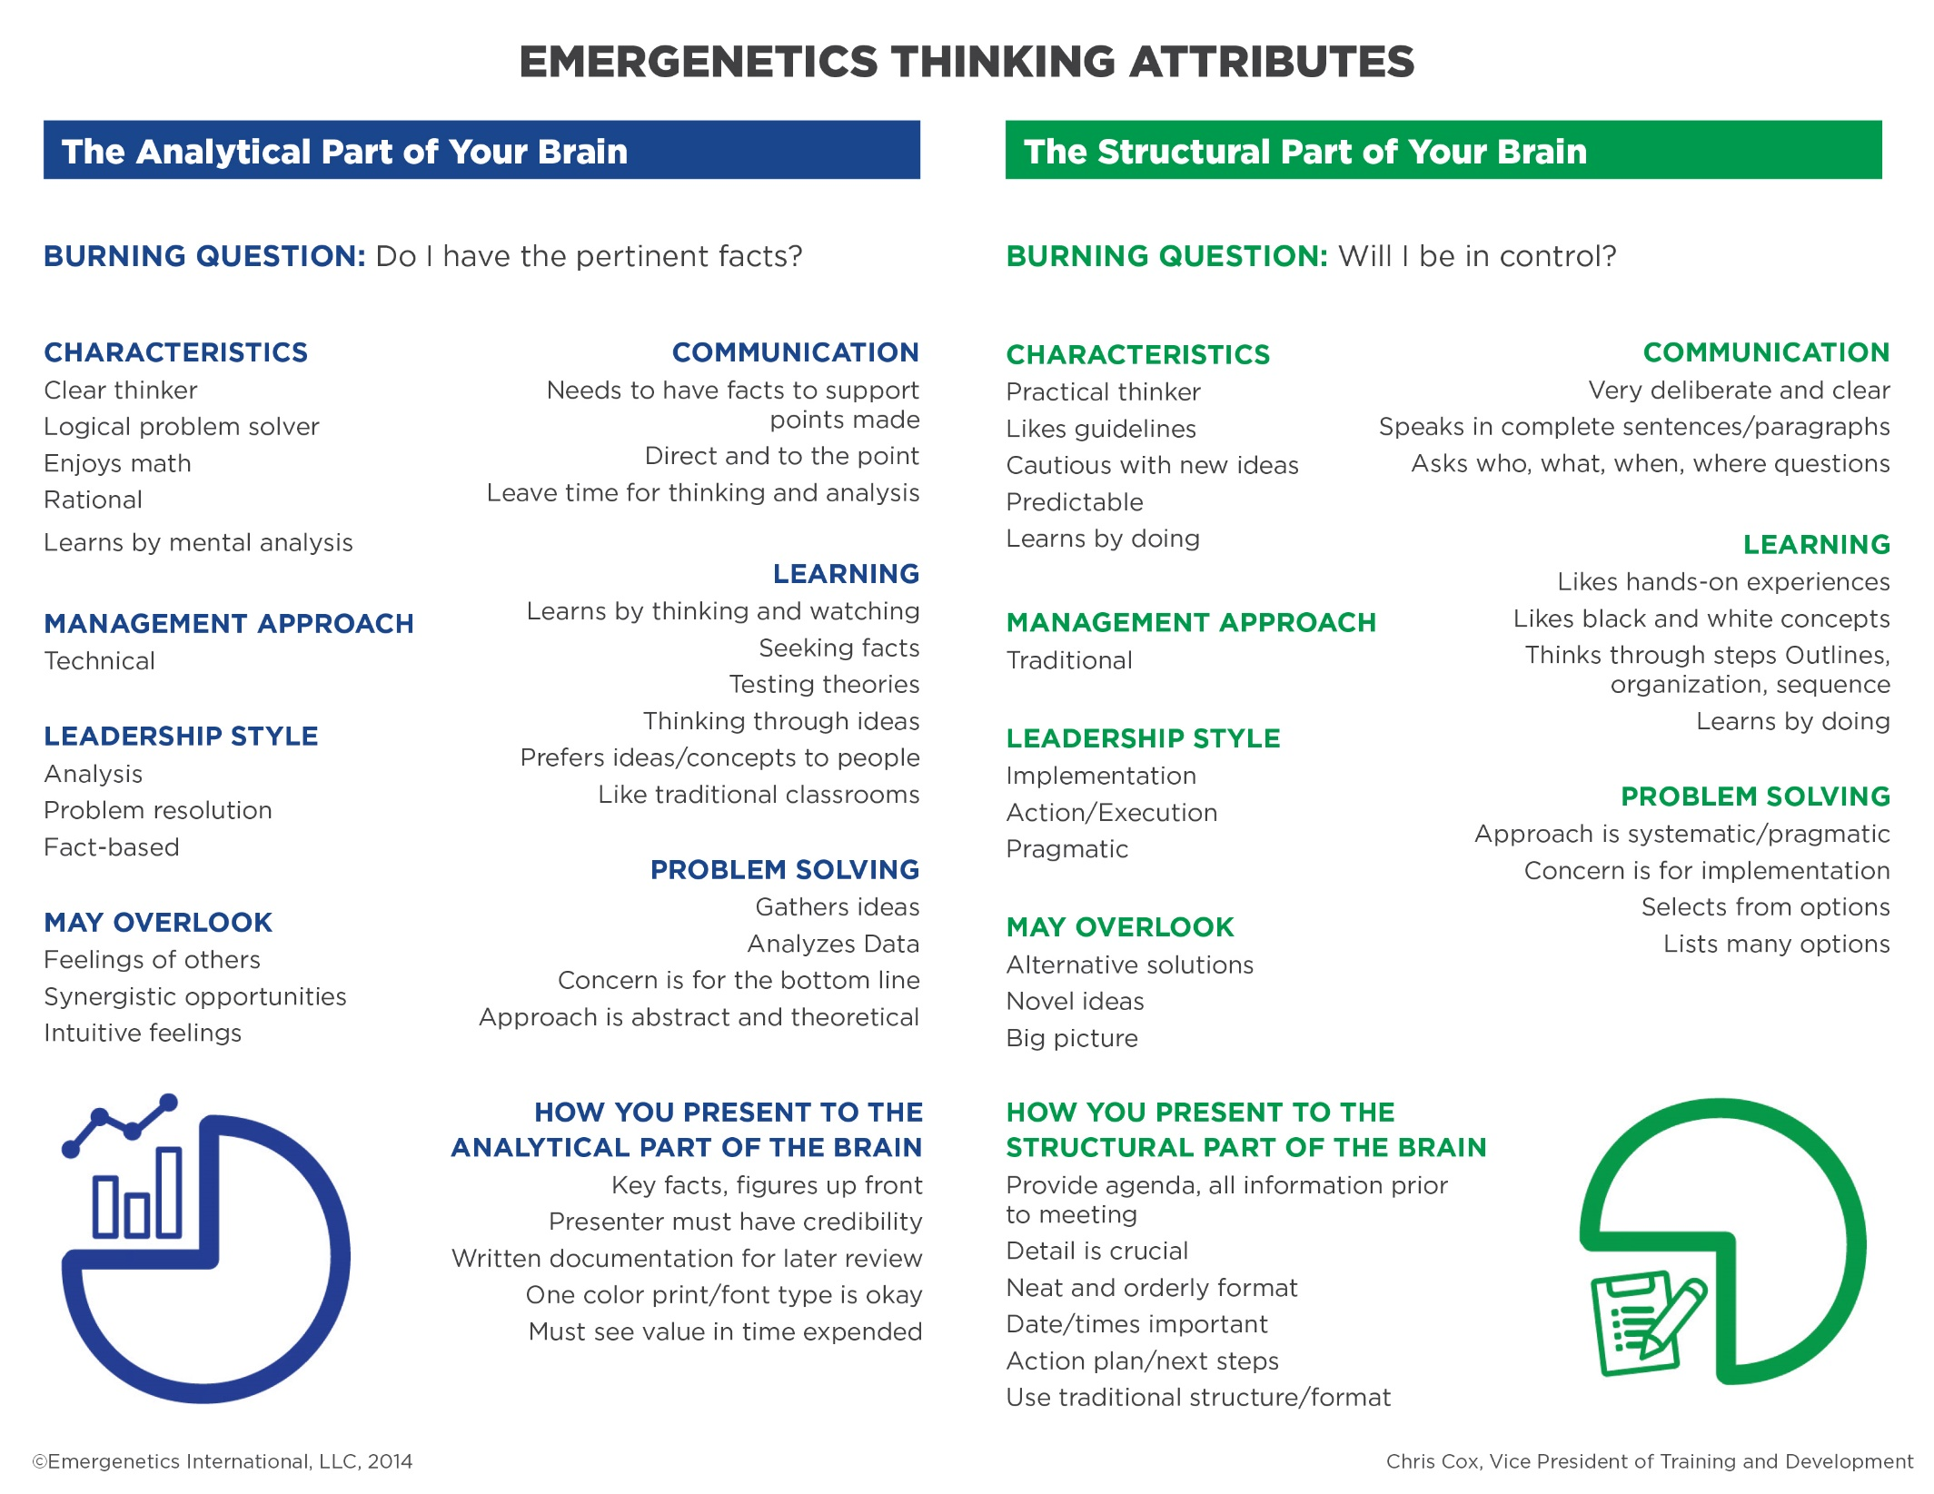

Slide 8
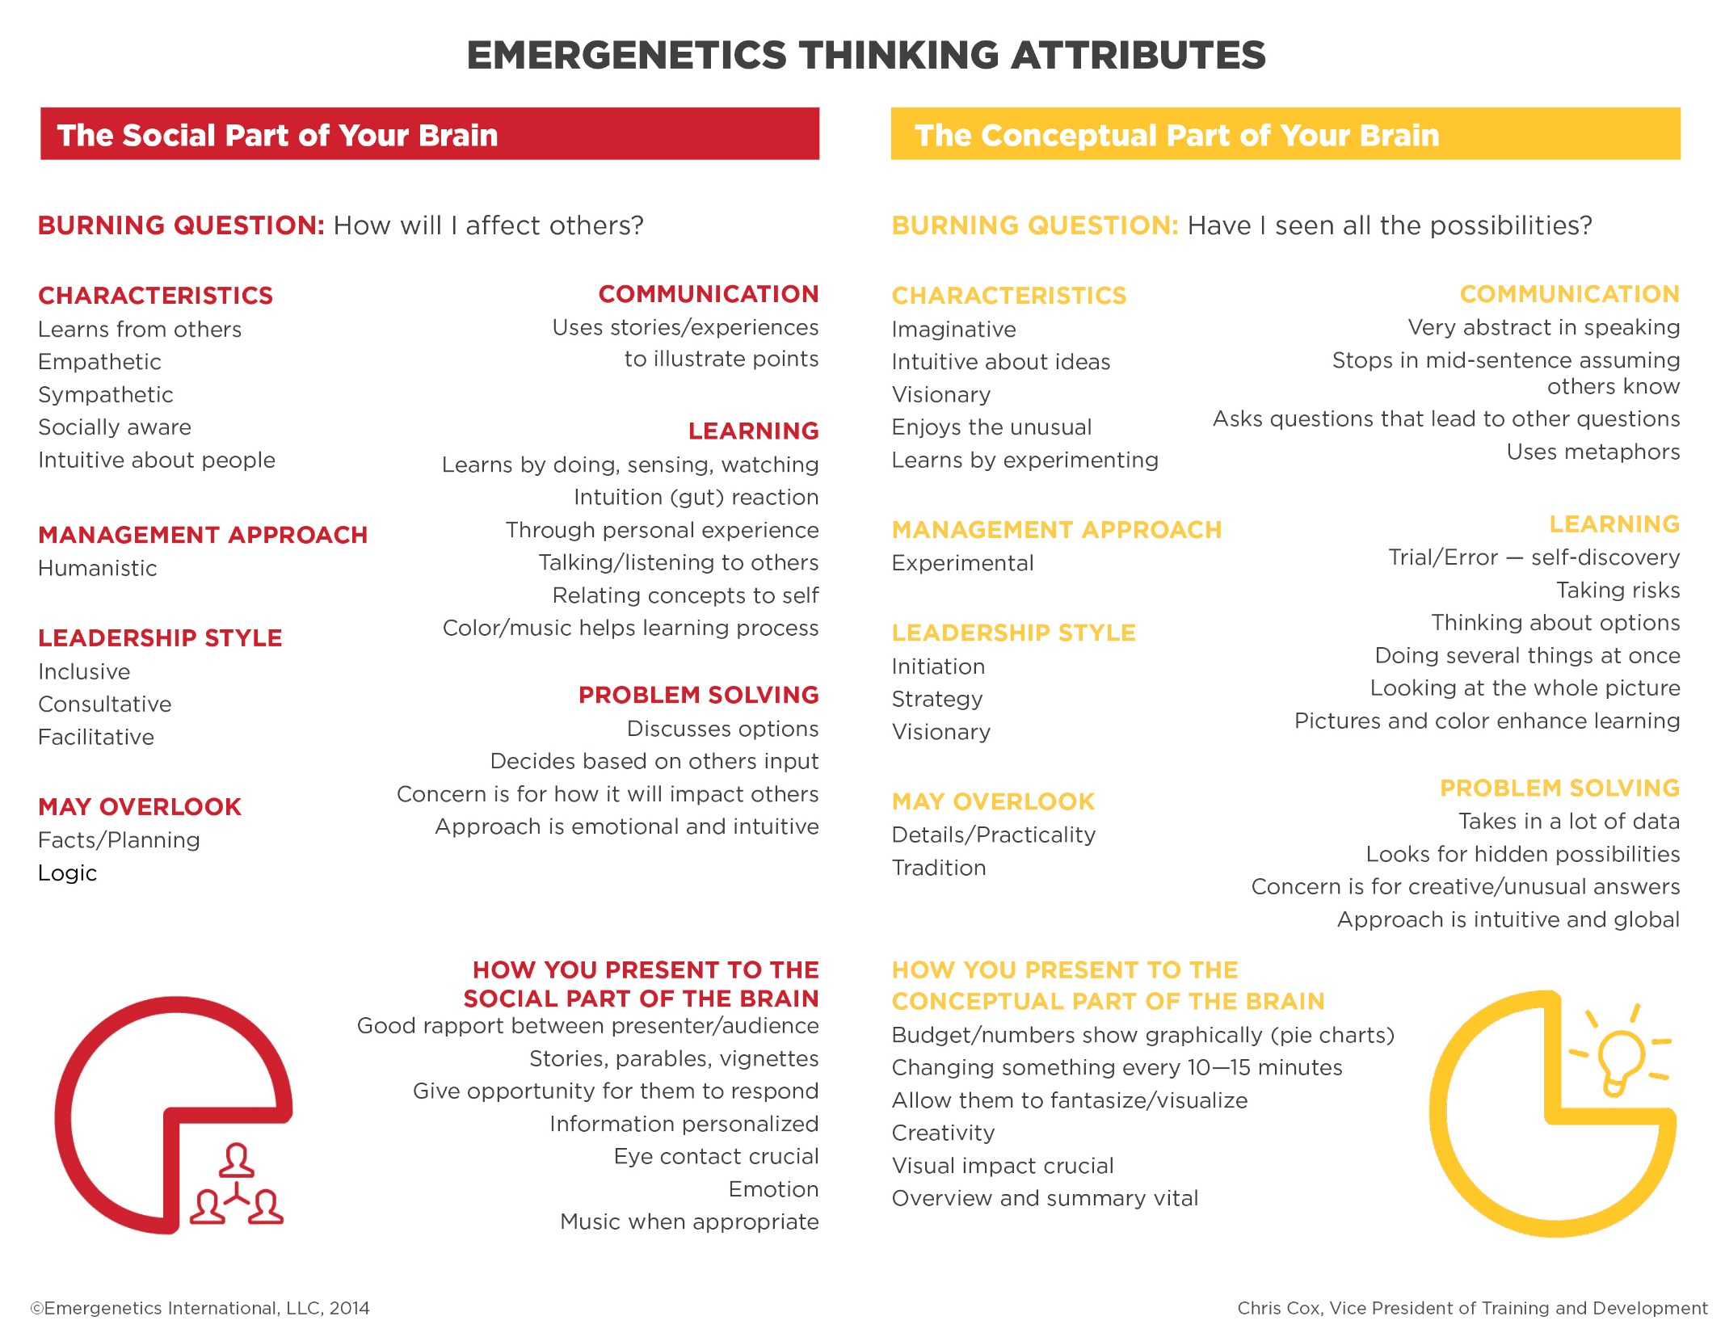

Slide 9
